Slide 1
Gabby John Photos & Figures
For LTER8 Year 4 Report

Slide 2
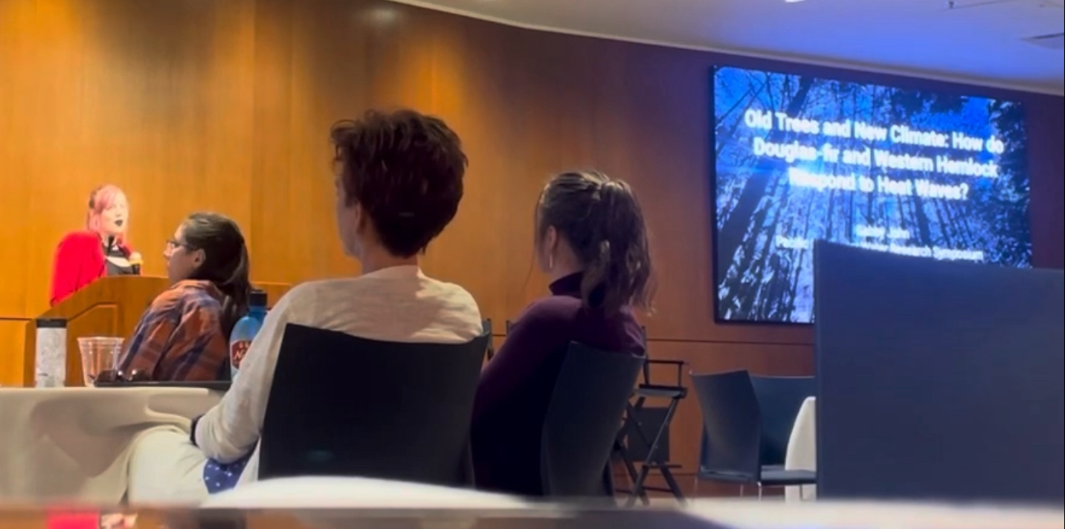
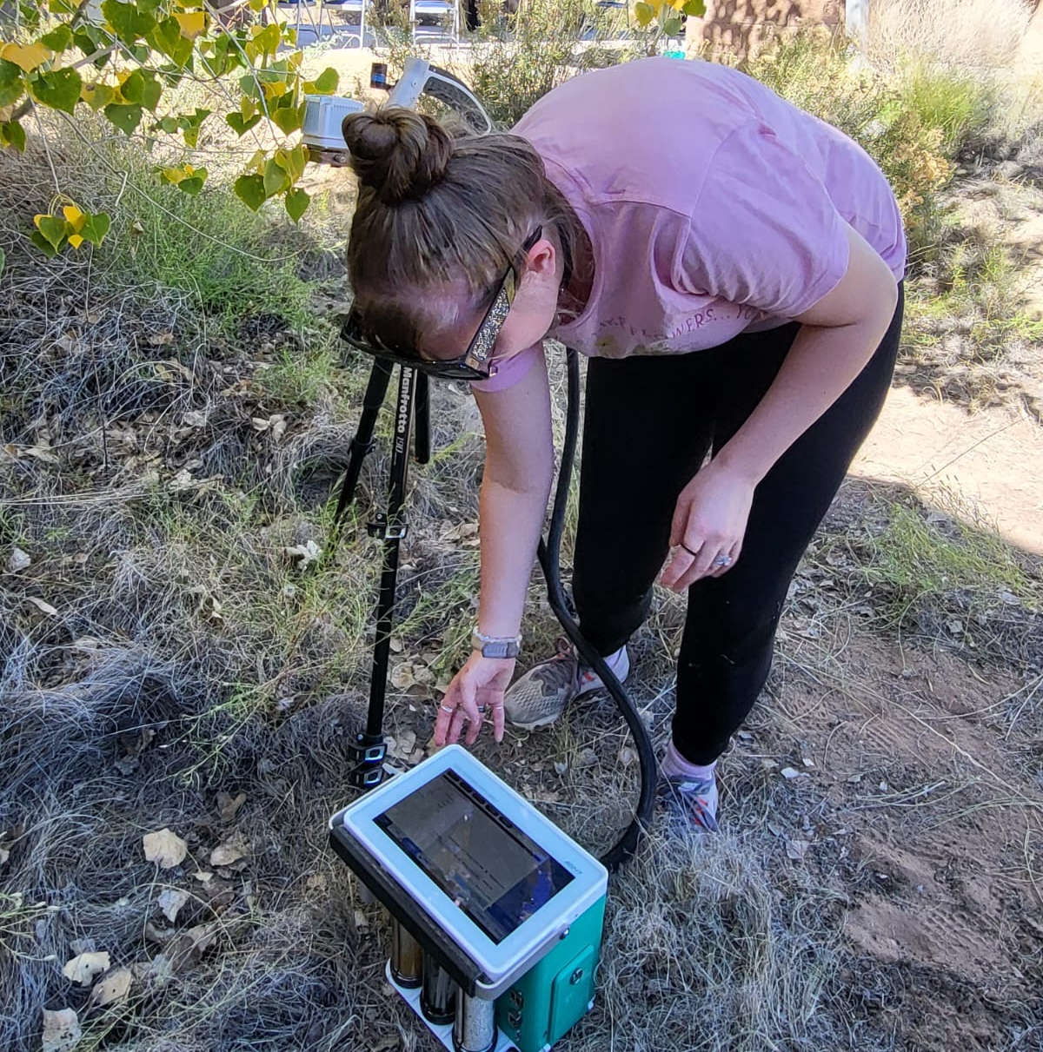
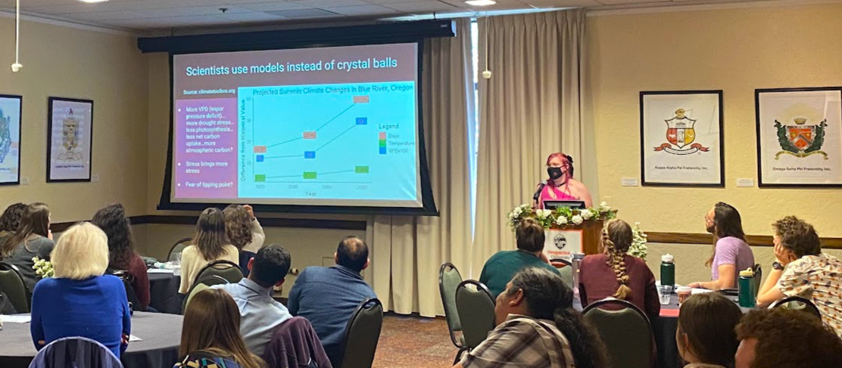
Photos from Presentations & Workshops
Caption: Gabby John presenting premise of MS work at the 2024 Pacific Northwest Water Research Symposium on May 20, 2024 in Corvallis, OR.
Caption: Gabby John using a LI-COR LI-6800 Portable Photosynthesis System during the ecophysiology workshop PhysFest taking place October 15-20, 2023 in La Joya, NM.
Caption: Gabby John presenting premise of MS work at the 2024 OSU Biology Graduate Student Symposium on April 5, 2024 in Corvallis, OR.

Slide 3
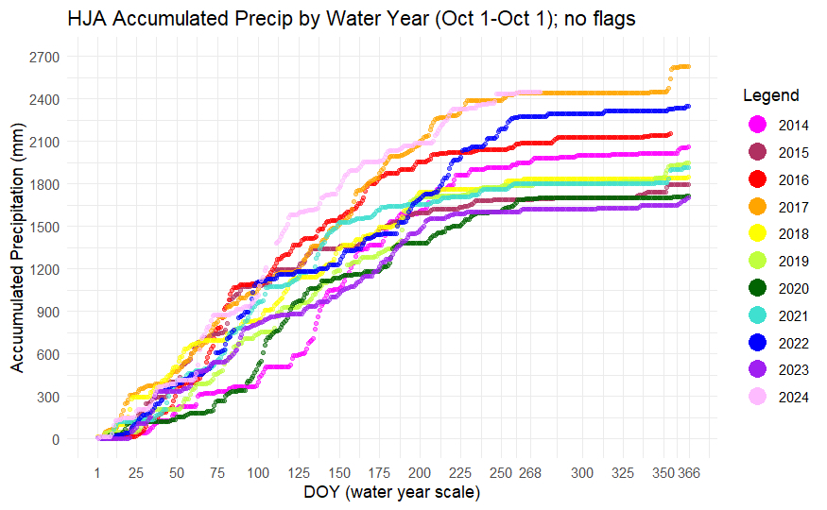
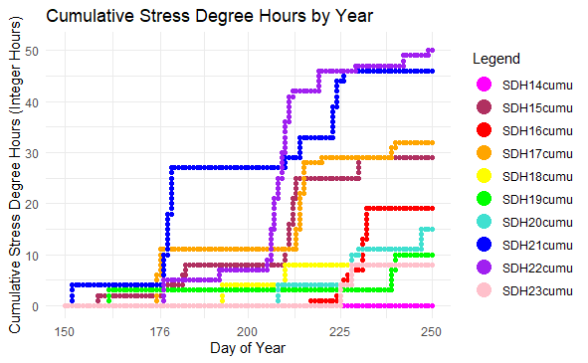
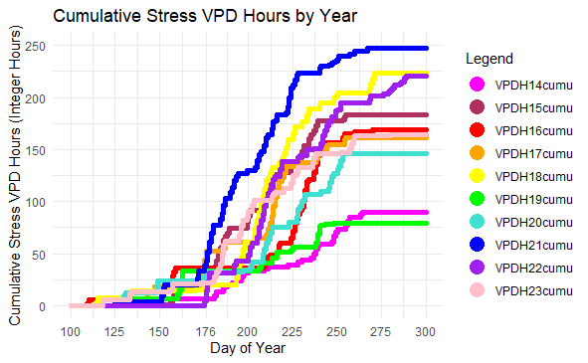
Photos from R Analyses
Caption Top Left: Accumulated precipitation (mm) at the HJ Andrews Forest on a water year scale. Data taken from the Primary Meteorological Station, PRIMET.
Caption Bottom Left: Accumulated stress degree hours (SDH) at the HJ Andrews Research Forest. SDH is defined as number of integer hours in which air temp equals or exceeds 35C. Data taken from the Discovery Tree Meteorological Station, DSCMET with PRIMET to fill gaps. SDH concept derived from Brackett, Still, & Puettmann 2024.
Caption Bottom Right: Accumulated stress VPD hours (SVPDH) at the HJ Andrews Research Forest. SVPDH is defined as the number of integer hours in which VPD equals or exceeds 3. Data taken from DSCMET with PRIMET to fill gaps.

